Slide 1




Slide 2







WONDERING WHO’S BEHIND THIS GUIDE? We’re a senior team of award-winning consultants who partner with leaders across all industries to make an impact and accelerate business through employee engagement, internal and leadership communication.
We work with clients to:
Do You Want to Make a Positive Impact? We help executive leaders who take on new roles to:
Build stronger leaders and communicators
Engage and activate employees
Help functions elevate their value
Transform culture to drive performance
Activate strategy to accelerate results
Lead organizations successfully through change
Develop their 100 Day Plan to set the right tone with their team, immerse in the business and achieve quick wins
Establish a core message platform and story library
Prepare and communicate organizational announcements
Tell their story and communicate the strategy in an effective way
Receive executive coaching and advising as they establish themselves in their roles
If you need help beyond this template, we’re happy to jump in, contact us today.
Find out what sets us apart from other agencies by reading The Grossman Group Difference

Slide 3

Table of Contents
While a 100 Day Plan for new leaders can take on many forms and is as unique as the business challenges leaders face, there are seven core components that the best plans have. Use this 100 Day Plan example framework as a guide:
GET A DETAILED HOW-TO GUIDE.
CLICK HERE
Situation Summary
Goals
Stakeholders/Audiences
Key Messages
Stakeholder Engagement and Communication Plan
Quick Win Tactics
Measures for Success

Slide 4


Situation Summary
Outline the current business landscape, strengths, opportunities, and other important headlines that capture the context you’re stepping into as a new leader. This might include the state of engagement at your organization, cost pressures, how employees perceive you as the new leader, and more. Take an employee-centric point of view and by key audience segments and then try to understand the challenge they need to overcome in today’s environment.
You may need to set-up informational interviews with a few key colleagues to help confirm some of your assumptions and to highlight details that you wouldn’t yet know.

Slide 5



Goals
NEAR-TERM: where you want to be 100 days in on the job? What impact do you want to have made and how does that line up to your longer-term goals?
List your goals, ensuring there are business metrics and relationship goals. For example: a relationship goal could be to establish credibility and build trust with key stakeholders. A metric for that could be to meet with site leaders and front-line employees at five sites in the first 30 days.
LONGER-TERM: what do you want people to say about you and the business 18 months from now and what are some of the big actions you might consider taking to make your vision a reality?
© 2023 The Grossman Group
> For help with your 100 Day Plan, contact us at results@YourThoughtPartner.com or 312.829.3242

Slide 6
Goals
Goal | Timeframe (long-term, near-term) | How you’ll get there | Metrics for success | Next actions

Slide 7


Stakeholders / Audiences
When you consider your stakeholders, think about big “centers of gravity” so you can separate out how to allocate time and where you can have the greatest impact by investing time and energy. Also, consider what key relationships you need you build because they’re critical to have bridges and sponsorship across the organization.
STAKEHOLDER TIP: While you’ll certainly want to focus on your direct reports, immediate peers, and leadership / decisionmakers, don’t forget to include any groups of influencers who you may want to collaborate with in the future.
By building those connections early on, you’re establishing a strong foundation for success going forward.
7
© 2025 The Grossman Group
> For help with your 100 Day Plan, contact us at results@YourThoughtPartner.com or 312.829.3242

Slide 8

Stakeholders / Audiences
REFER BACK TO THE 100 DAY PLAN GUIDE FOR ADDITIONAL INSIGHTS
Identify who the key stakeholders and audiences are that you need to get to know, understand, build partnerships within your team and across the organization. Start thinking about what you’d like them to know, feel, and do as you get to know one another.
 |  | KNOW | FEEL | DO:
<Insert> |  | <Insert> | <Insert> | <Insert>
<Insert> |  | <Insert> | <Insert> | <Insert>
<Insert> |  | <Insert> | <Insert> | <Insert>
<Insert> |  | <Insert> | <Insert> | <Insert>
KEY STAKEHOLDERS
You’ll likely need to to build some key relationship without necessarily a Know / Feel / Do. Don’t forget to capture that list, too.

Slide 9
Stakeholder List
Once you’ve mapped your audience list and have clarity on what you need them to know, feel and do, use this framework to organize next steps and key message headlines (your full set of key messages will come later).
Name | Action or mindset needed | What they need to overcome | Key messages to seed | Next actions

Slide 10

Key Messages
Articulate what the main messages are that you want to convey as you get to know your various key stakeholders.
THESE MAY INCLUDE:
Themes that you know you want to highlight about your leadership style
Your vision for the role
High-level examples of how you view your function tying into broader company goals and strategies
A list of commitments you are making to your staff and the actions you are asking them to take while you settle in

Slide 11

Stakeholder Engagement and Communication Plan
With the steps you've already completed—goals, stakeholder / audience, key messages—you've done a lot of the heavy lifting when it comes to creating a stakeholder engagement and communication plan.
Now is the time to pull those parts together into an actionable roadmap that you (and your Communications team, if you have that level of support) will bring to life. This is a must in order to be intentional in your first 100 days (and beyond) about which stakeholders and audiences you are reaching, the best approach to do so, and the outcomes you want to see.
Take this opportunity to bring together the insights you've gathered about your stakeholders through the Know/Feel/Do chart and the high-level key messages you've outlined to create action-oriented, audience-customized messages that speak to and enable your outcomes. This also is when your elevator speech or platform, if you have one, will be especially useful.
As you're building out and fine-tuning your audience-specific messages, make sure they are answering:
WHAT (what’s happening and what to focus on for now)
WHY (rationale and context)
WHEN (a sense of timing for what’s happening and what’s to come)
HOW (how you’re approaching the coming weeks, how they can help, how you’ll use their insights to develop your action plan)
WHO (who you are, what brings you here, what’s important to you, what they can expect from you, and what you expect from them)
WIIFM (what’s in it for “me” – in other words, what all of this means for them)
Use this 5 Step Planning Template to map your communications. It helps you capture:
Outcome
Audience
Message
Method
Measurement

Slide 12
Stakeholder Engagement and Communication Plan, CONTINUED
Make a plan for how you’ll purposefully reach your stakeholders and how you’ll communicate your messages over time to accomplish your goals. Look for communication channels that already exist so you can simply plug-in without having to build infrastructure, and don’t underestimate the value of informal conversations and small group huddles as a powerful vehicle while people are getting to know you.
 |  | CHANNELS
 |  | <INSERT CHANNEL> | <INSERT CHANNEL> | <INSERT CHANNEL>
<Insert stakeholder group> |  | <Insert message/call to action> | <Insert message/call to action> | <Insert message/call to action>
<Insert stakeholder group> |  | <Insert message/call to action> | <Insert message/call to action> | <Insert message/call to action>
<Insert stakeholder group> |  | <Insert message/call to action> | <Insert message/call to action> | <Insert message/call to action>
<Insert stakeholder group> |  | <Insert message/call to action> | <Insert message/call to action> | <Insert message/call to action>
KEY STAKEHOLDERS & CORE MESSAGE

Slide 13
Quick Win Tactics
Identify opportunities to generate quick and meaningful wins that demonstrate progress to your overall goals. It is easy for leaders to get caught up in the long game, focusing on the notable impact they aspire to make within a business, but it’s the small wins along the way that both give you something to celebrate and help your stakeholders appreciate the impact you are already making.
AUDIENCE (Insert) | AUDIENCE (Insert) | AUDIENCE (Insert)
1. TACTIC (insert) <Insert> | 1. TACTIC (insert) <Insert> | 1. TACTIC (insert) <Insert>
2. TACTIC (insert) <Insert> | 2. TACTIC (insert) <Insert> | 2. TACTIC (insert) <Insert>
3. TACTIC (insert) <Insert> | 3. TACTIC (insert) <Insert> | 3. TACTIC (insert) <Insert>

Slide 14

Measures for Success
Consider how you’ll know when success is achieved. Identify the metrics and how you’ll monitor progress—remember, this is a 100 Day Plan, so the metrics should fit accordingly with that timeline.
For example, a measure could be around moving sentiment – such as belief in the company, confidence and optimism in the future, clarity around where we’re heading and why.
Use the progress in your stakeholder engagement and communication plans to show momentum.

Slide 15
EXAMPLE 3 MONTH ACTION PLAN
> For help with your 100 Day Plan, contact us at results@YourThoughtPartner.com or 312.829.3242
© 2025 The Grossman Group

Slide 16
Sample 100 Day Action Plan
Following is a sample 100 Day Plan that shows how to quickly and strategically build out your approach. You can simply customize this list, or you can use the list for inspiration to develop a more detailed plan in alignment with your organization’s preferred format.
BEFORE YOU GET STARTED:
CONTINUE TO LEARN as much as you can about the organization and your team
HAVE PRE-MEETINGS with identified stakeholders to discuss game plan and listen for key expectations, issues, and opportunities
BEGIN TO MAP key stakeholders
GET BRIEFED on the employee, culture, and communication landscape (set up an initial meeting with the Communications team, if possible)
CONSIDER HAVING an informal visit with your new team over breakfast or lunch
PREPARE your elevator speech and/or your initial message platform

Slide 17
Your 100 Day Action Plan
Month 1 | Month 2 | Month 3
Create a list for your Listening plans, outlining who all you need to meet with to hear perspectives, observe, and tap for insights: set up meetings with key stakeholders (including senior leaders, peers, direct reports, and skip-level reports/teams); if you don’t yet know their names, list their roles to prompt you to then find out the right point of contact Begin your listening “tour;” reinforce that you’re hearing what people are saying and make a point to circle back with anyone who asked a question that you couldn’t answer in the moment Connect with Communications and HR partners to understand company culture and how communication happens Set the stage with your team and stakeholders with what to expect these first days and weeks, including what to continue to focus on and do Identify key contributors and any key people who are flight risks on your team and engage with them, including conducting stay interviews Actively participate in company onboarding so you experience what others also experience | Continue listening tour Work with team members to codify strategy; involve people representing a cross section of organization whenever possible Identify communication channels you’ll regularly use to share updates on what you’re hearing, doing, and thinking in advance of the formal launch of your communications plan | Continue listening tour Finalize your strategy and plan and socialize with key stakeholders for alignment Develop communication plan for playback of listening and to share strategy going forward Refresh key messages and leader platform Implement communication plan Continue steady cadence of employee listening and update/amend plan and messages in real time based on new, viable insights that come from listening and any key changes within the business or your work environment

Slide 18





RECIPE FOR SUCCESS
Read more case studies
As the search for a new CEO of a global consumer packaged goods organization neared completion, all eyes were on the Communications team to lead the way in introducing the new leader and establishing a new era for the company. Having been burned in the past with unexpected flare ups when communicating big news, they called in The Grossman Group so that communications scenarios were well prepared and went smoothly.
The Grossman Group:
Prepared announcement plans and materials to be ready with same-day announcements reaching key internal and external audiences
Leveraged the “gap” period between the CEO announcement and start date to prepare his communications, including developing his leadership platform, visibility and communication plan and acclimating him to the employee environment so employees could quickly get to know him and what he’s about
Developed leader tools and communications to connect employees to the new CEO’s vision and strategy
Worked with executives on the ELT to communicate key business unit changes and plans as the strategy evolved under new leadership
CEO announcement was executed FLAWLESSLY
New CEO hit the GROUND RUNNING

Slide 19
GOING BEYOND YOUR FIRST 100 DAYS

Slide 20
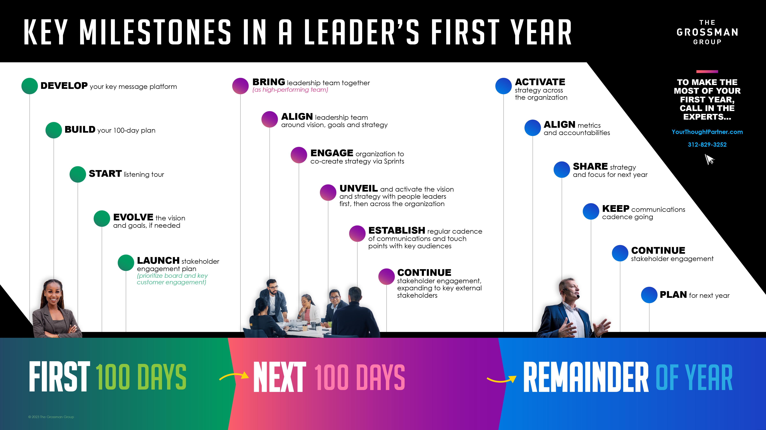

Slide 21




Are you ready to partner with a team who can help you accelerate your impact? CONTACT US TODAY

