Slide 1

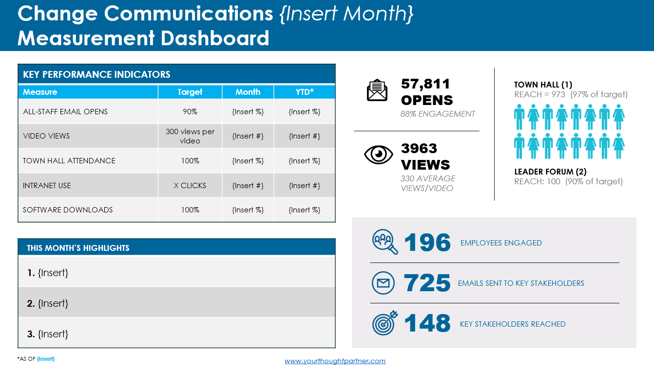

Change projects typically require regular reporting to track progress of key performance indicators (KPIs), and communication results should be part of this regular cadence. Consider using this template or something similar to document and reinforce the importance and value of change communication activities. A fully editable slide follows on the next page. Keep the prompts that are relevant to your change project and update any others as needed.
Change Communication
Measurement Dashboard Template
Decide on a cadence that works for your project (e.g. month or quarter)
Modify this chart with your KPIs, targets and results
Call attention
to notable accomplishments in each report
Use icons and graphics to draw attention to the most important data
© The Grossman Group
www.yourthoughtpartner.com | @ThoughtPartner

Slide 2






Change Communications {Insert Month}
Measurement Dashboard
KEY PERFORMANCE INDICATORS
Measure | Target | Month | YTD*
ALL-STAFF EMAIL OPENS | 90% | {Insert %} | {Insert %}
VIDEO VIEWS | 300 views per video | {Insert #} | {Insert #}
TOWN HALL ATTENDANCE | 100% | {Insert %} | {Insert %}
INTRANET USE | X CLICKS | {Insert #} | {Insert #}
SOFTWARE DOWNLOADS | 100% | {Insert %} | {Insert %}
57,811
OPENS
88% ENGAGEMENT
TOWN HALL (1)
REACH = 973 (97% of target)
3963
VIEWS
330 AVERAGE VIEWS/VIDEO
LEADER FORUM (2)
REACH: 100 (90% of target)
196
THIS MONTH’S HIGHLIGHTS
1. {Insert}
2. {Insert}
3. {Insert}
EMPLOYEES ENGAGED
725
EMAILS SENT TO KEY STAKEHOLDERS
148
KEY STAKEHOLDERS REACHED
*AS OF {Insert}
www.yourthoughtpartner.com
Notes:
Enter the information on the measures and targets you are using under “Key Performance Indicators”
Each month, enter and update information on results for the month and year-to-date figures
Summarize key highlights you want to merchandise below it
Use the graphics on the right as alternate ways to showcase the data

